Slide 1
The Food Delivery Website
RLL PROJECT
Group Number- 6

Slide 2

Team Members
Shreya X (Team Lead)
Manovikash B
Karnati Alekhya
Lakshmidevi P
Lingala Lakshmi
Maheshwari Veerasamy
Chitti Manasa
Namineni Vishal
Galla Venkata Achyuth
Yattapu Sudeepa

Slide 3

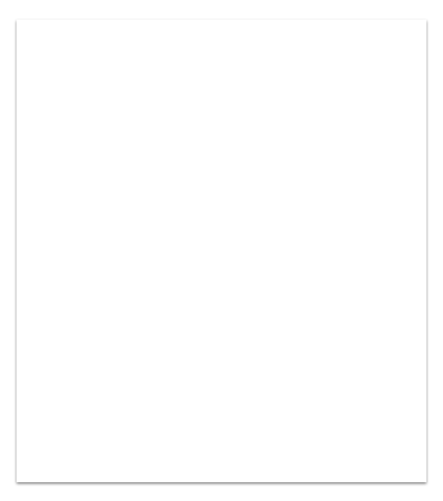
Table Of Contents
Introduction
Project overview
Solution Summary
Functional Requirements
System Design
Backend
Frontend
Testing
Integration
Output Screenshots

Slide 4
What tasks are going to be performed by our Website ?
Solution
To provide a bug free online food delivery system to users as well as admins by providing a secure platform for ordering food and to maintain the records of product, category available into the system.

Slide 5
Introduction:
Purpose of this Document - This document aimed at:
Providing detailed information about the website developed for admin and users through a portal.
Also aims at providing the technical specifications like tools used for development, testing and executing the application.
It also highlights the working of the application through diagrams for a better understanding.
Project Overview - Creating an online repository that contains all the user stories regarding the food delivery website.
Intended Audience - Mentors and SMEs.

Slide 6
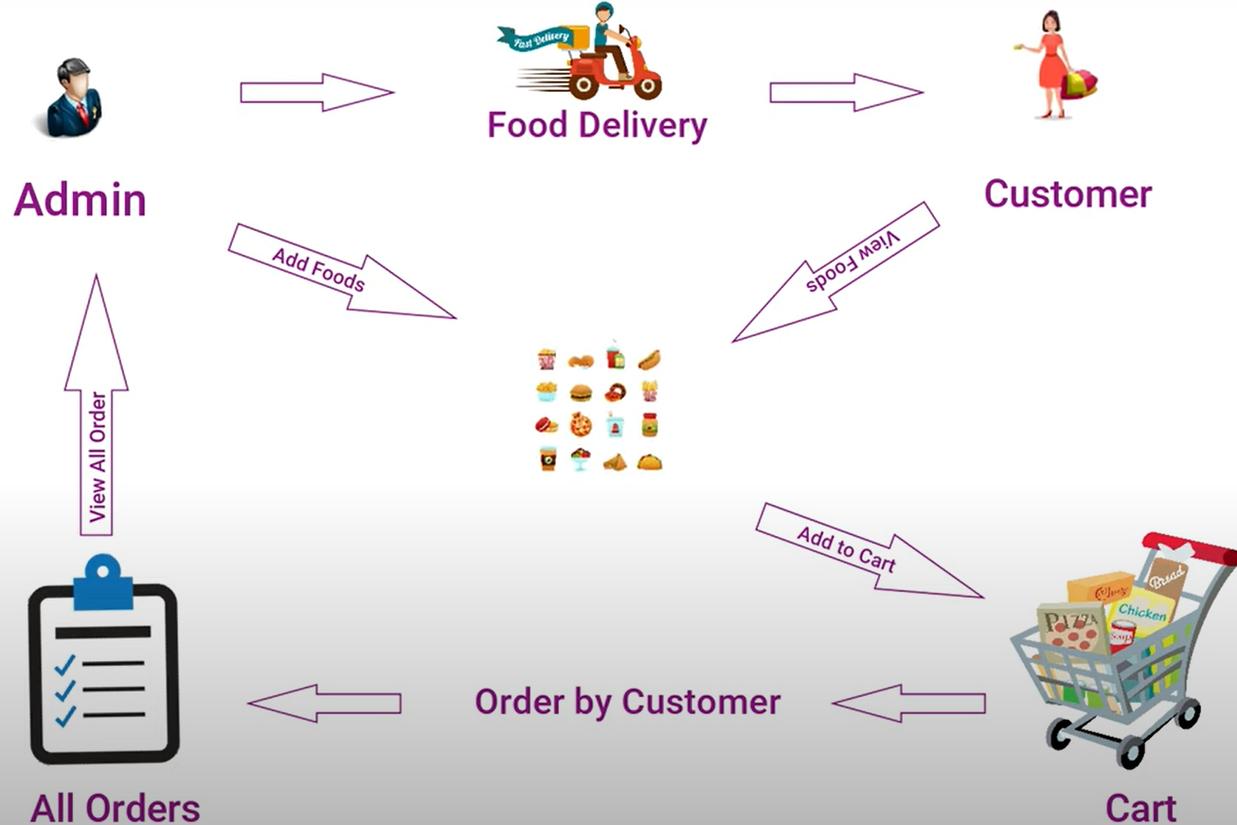

Slide 7
Scope: This project aims to provide the backend and frontend features and functionalities for the listed requirements after that we will move to updating more existing backend features.
Dependencies- Following dependencies are included in the project:
MySQL Workbench
Angular
Visual Studio Code
Spring Tool Suite
Spring Data JPA
Spring Web
Junit
Postman

Slide 8
Functional Requirements
Admin Functionalities:
1. Login to portal
2. Add or remove cuisines to or from the application to build a rich product line
3. Edit food item details like name, price, cuisine and description.
4. Delete food items

Slide 9
User Functionalities
1. Register to the application
2. Sign into the application to maintain the record of activities
3. Search for food items based on the search keyword
4. Apply filters and sort results based on different cuisines
5. Add all the selected food items to a cart and customize the purchase at the end
6. Perform a payment process
7. Summary of the order

Slide 10
System Design

Slide 11
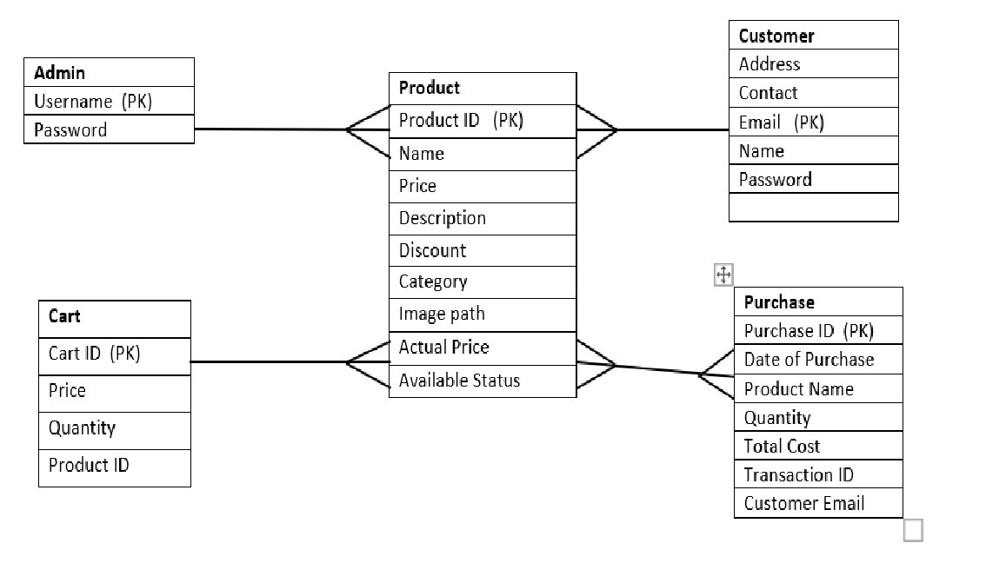
ER Diagram

Slide 12
Backend

Slide 13
Spring Boot
Spring Boot is a Java framework, built on top of the Spring, used for developing web applications.
Spring Boot is a backend framework that has become a major player in the enterprise Java EE.
No requirement for complex XML configurations.
It allows you to create REST APIs with minimal configurations.
A few benefits of using Spring Boot for your REST APIs include:

Slide 14
Rest APIs
API is to standardize data exchange between web services. Depending on the type of API, the choice of protocol changes.
REST API is an architectural style for building web services that interact via an HTTP protocol.
In Spring's approach to building RESTful web services, HTTP requests are handled by a controller
REST stands for representational state transfer.
Postman is an application used for API testing. It is an HTTP client that tests HTTP requests, utilizing a graphical user interface, through which we obtain different types of responses that need to be subsequently validated.

Slide 15
Backend Flow
1. Creating Entities ,Controllers for the below Modules
2. Admin
3. Product
4. Customer
5. Cart
6. Purchase
7. Performing CRUD operations for above Modules using JpaRepository

Slide 16
Dependencies and Annotations Used
1.Spring Data JPA – Java Persistence API and Hibernate.
2.Spring Web – To include Spring MVC and embed Tomcat into your project.
3.Spring Boot DevTools – Development Tools.
4.MySQL Driver – JDBC Driver (Connecting Spring Boot
to the Database)
5.Junit

Slide 17
Frontend

Slide 18
Angular
AngularJS is an open source javascript framework that is used to build java applications.
It is a framework which makes you able to create reactive Single Page Applications (SPAs). Angular is completely based on components. It consists of several components which forms a tree structure with parent and child components.
Angular MVC pattern is made up of 3 parts:
Model
View
Controller

Slide 19
Cross-platform
Efficient MVC architecture
Data binding
DOM
Prominence of TypeScript
Extensive documentation and support
Timely upgradations
FEATURES OF ANGULAR

Slide 20
Home
header
Admin login
Admin dashboard
Product
Cart
Manage customer
Manage purchase
Payment gateway
Order summary
Components in Angular

Slide 21
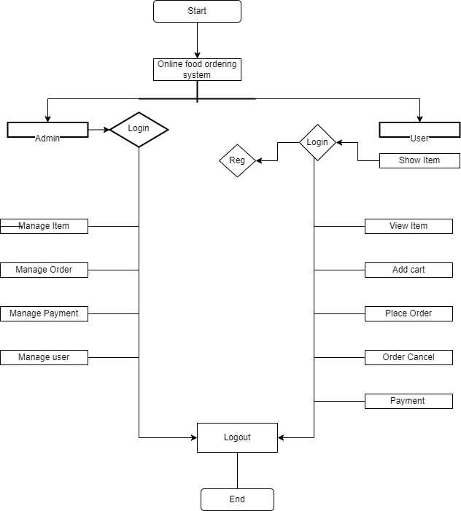
Flow Chart

Slide 22
Testing

Slide 23
Unit Testing -
A unit test is a way of testing-the smallest piece of code that can be logically isolated in a system. It is the important phase of the SDLC.
Testing promotes code reliability, robust software delivered to the clients if implemented correctly.

Slide 24
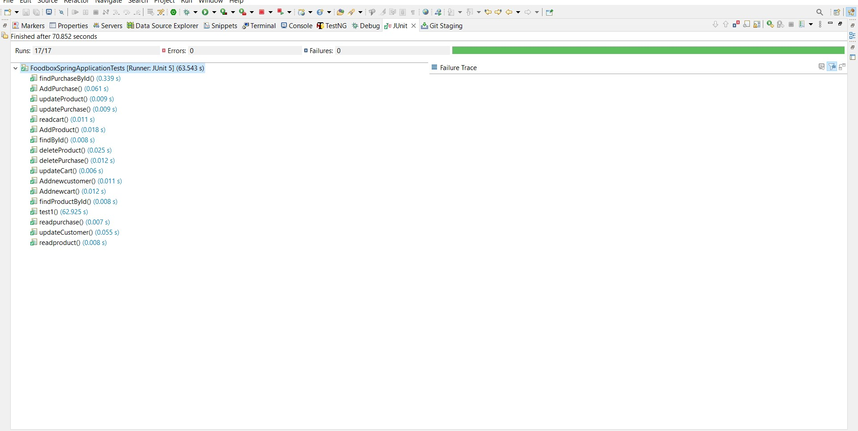

Slide 25
Postman Testing
Postman is an API testing tool.
API acts like a interface between a couple of applications and establishing a connection between them.
Postman has the feature of sending and observing the http requests and response.
It can build multiple Http requests - POST, PUT, GET, PATCH
and translate them to code.

Slide 26
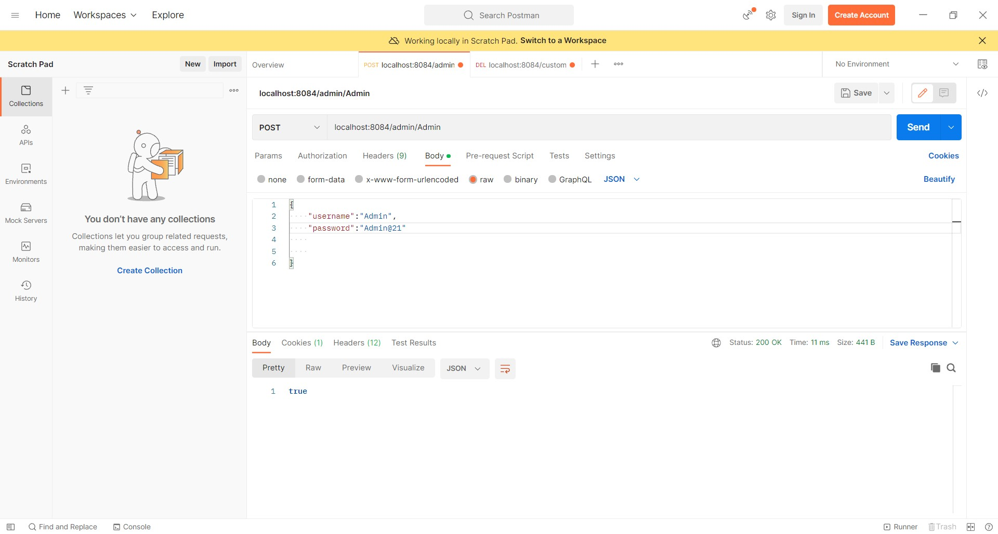

Slide 27
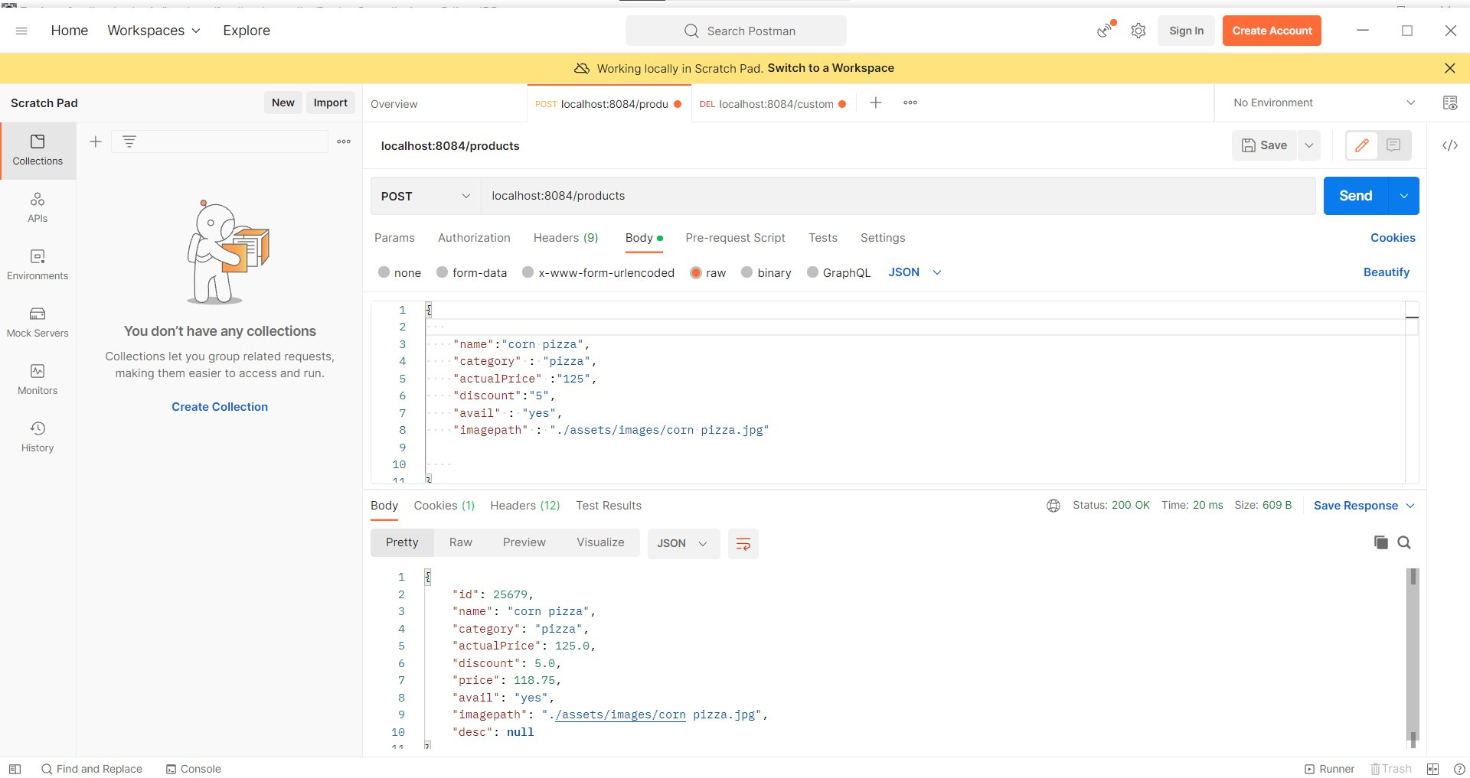

Slide 28
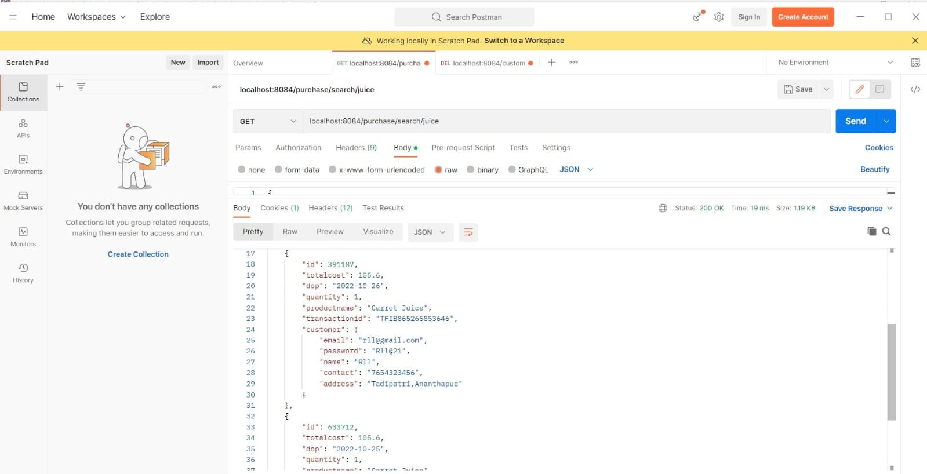

Slide 29
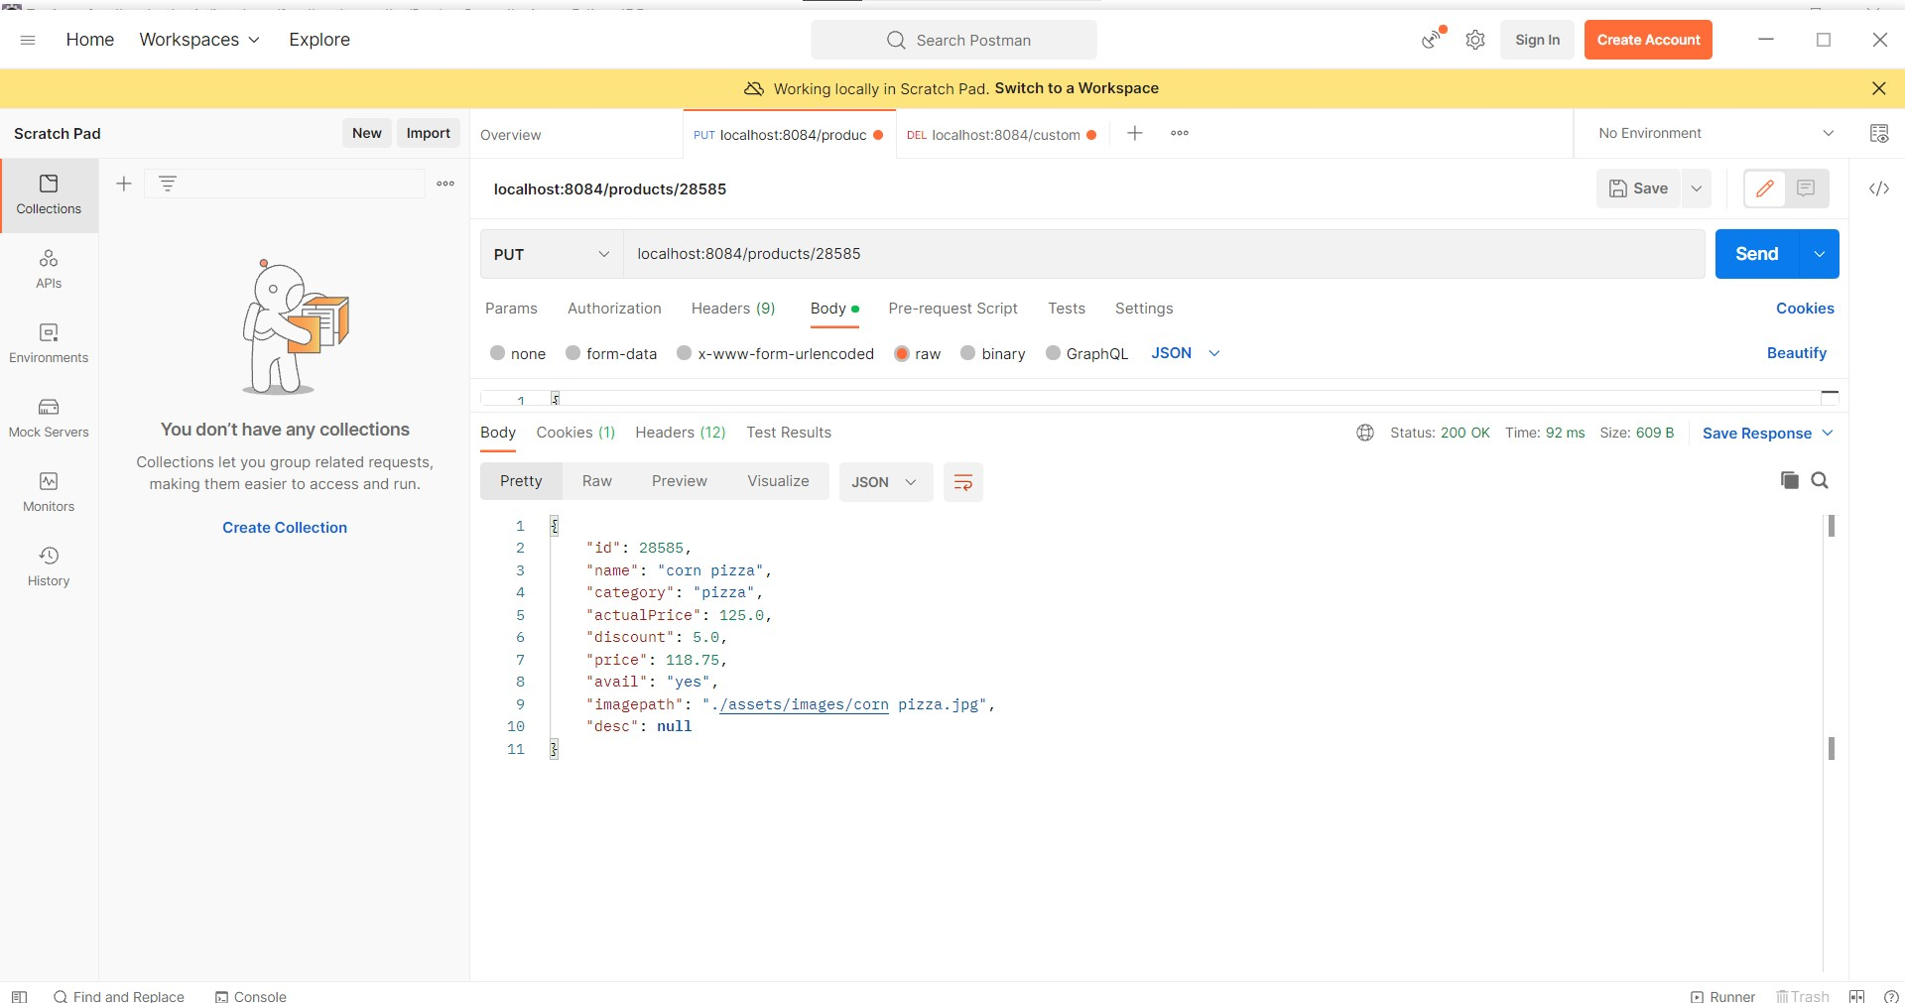

Slide 30
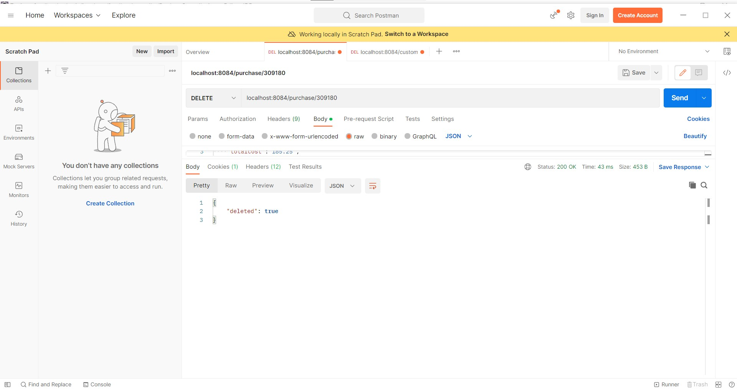

Slide 31
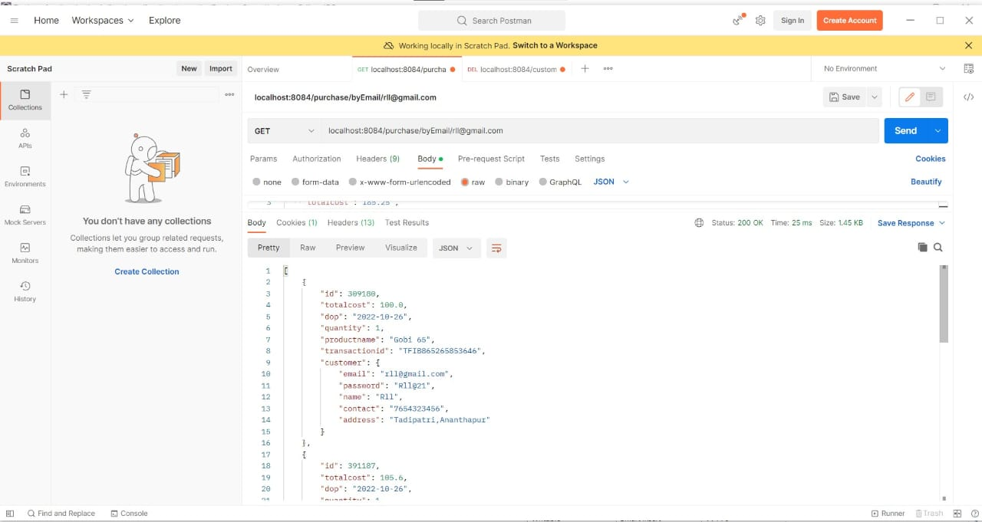

Slide 32
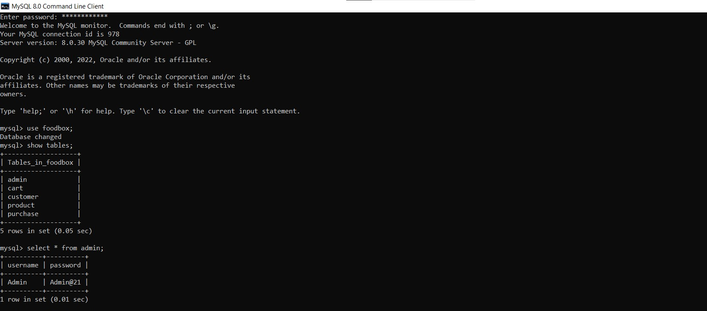
Database

Slide 33
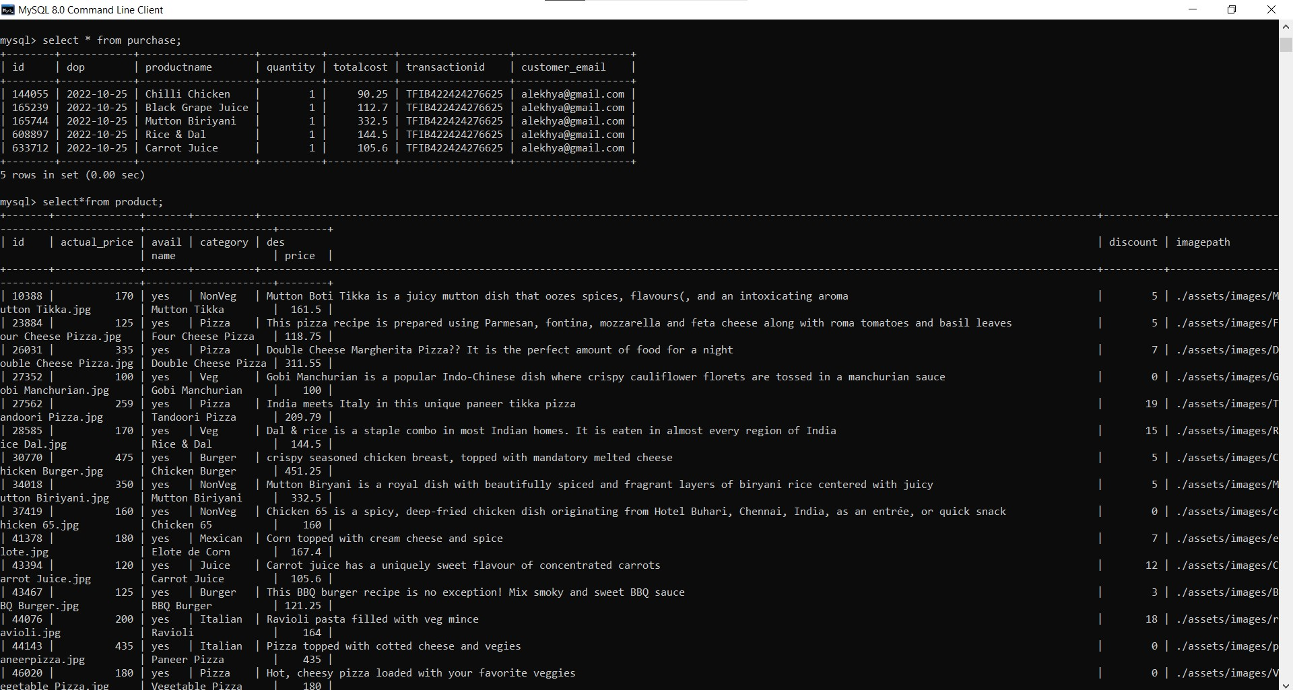

Slide 34
Integration

Slide 35
Backend is connected to frontend through
base URL= “http://localhost:8084”
Similarly frontend is connected to backend through cross origin annotation.
@CrossOrigin(origins = "http://localhost:4200")
Mysql database is connected to the backend application.properties file.
spring.datasource.url=jdbc:mysql://localhost:3306/foodbox
spring.datasource.username=root
spring.datasource.password=password

Slide 36
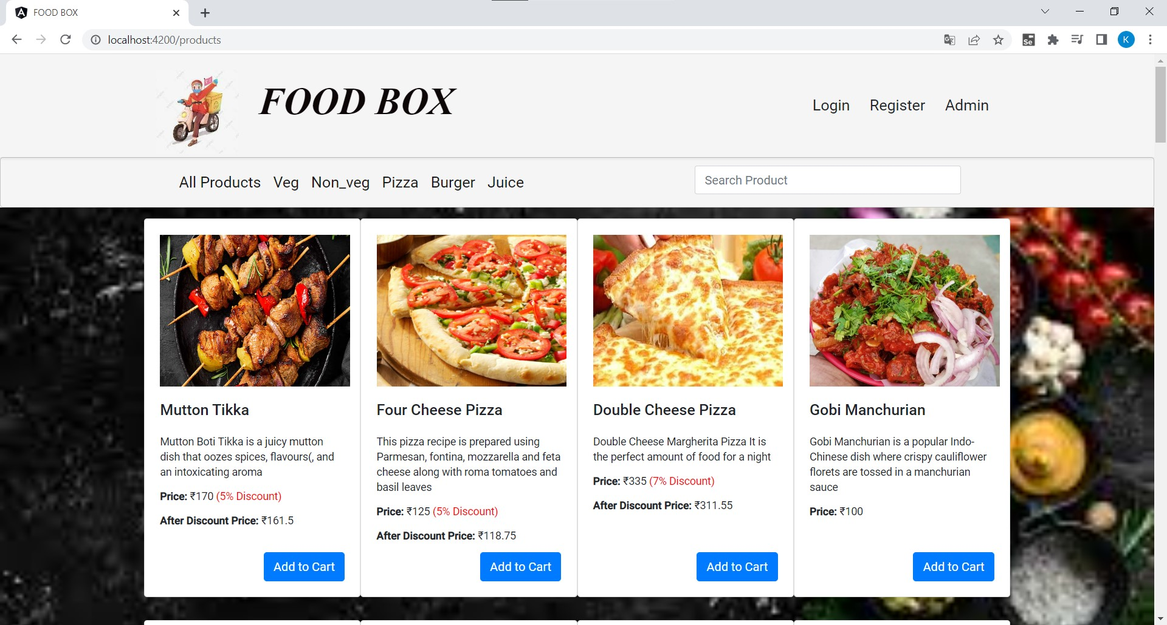
Output Screenshots
Home Page

Slide 37
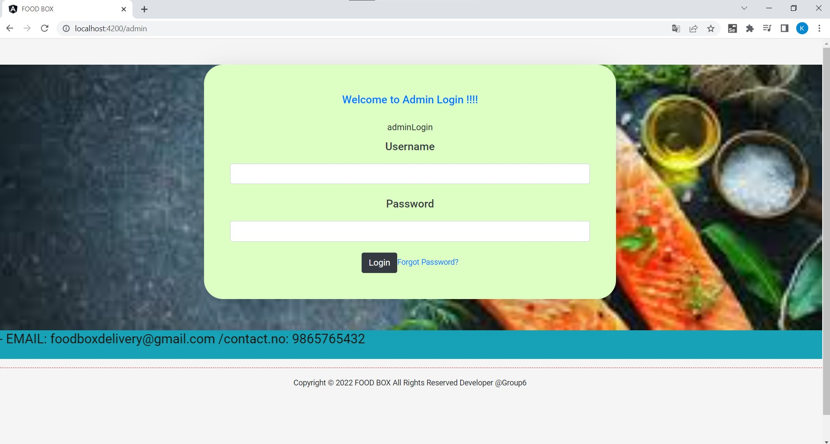
Admin Login

Slide 38
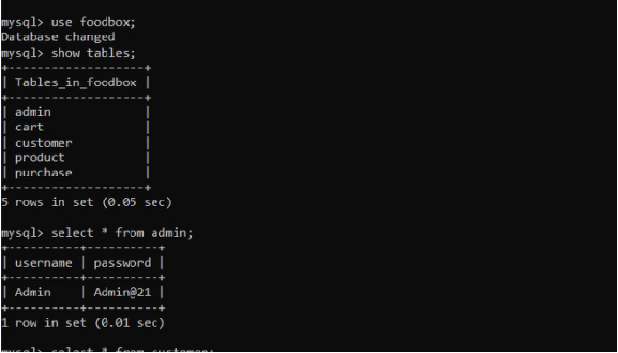
Admin Credentials

Slide 39
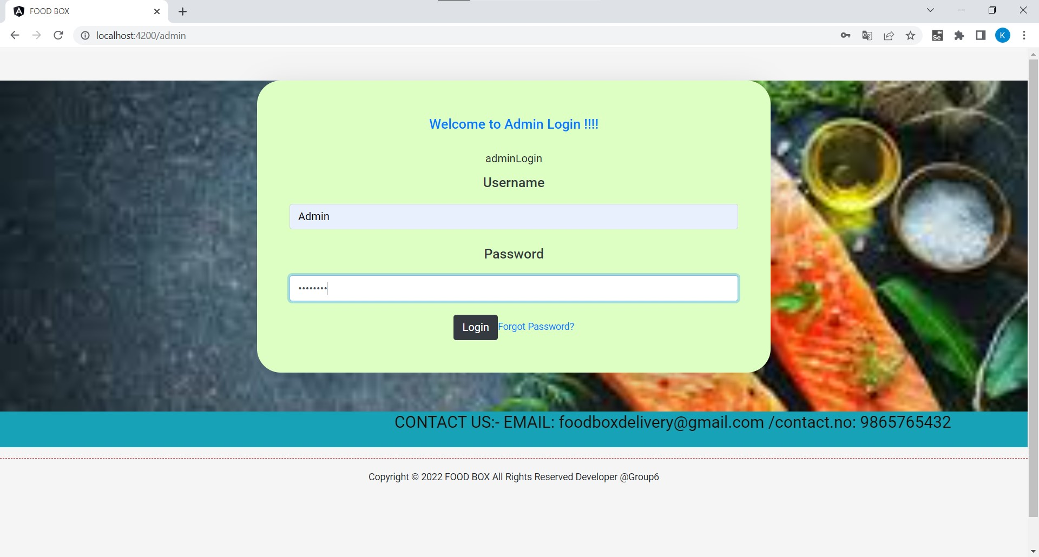

Slide 40
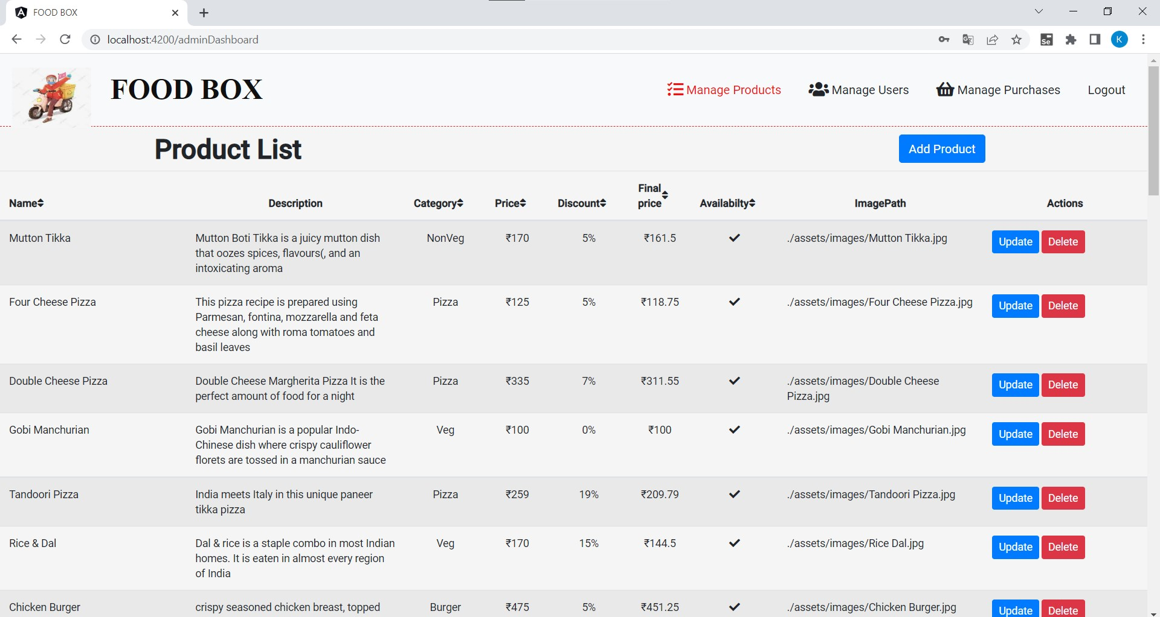
Product details

Slide 41
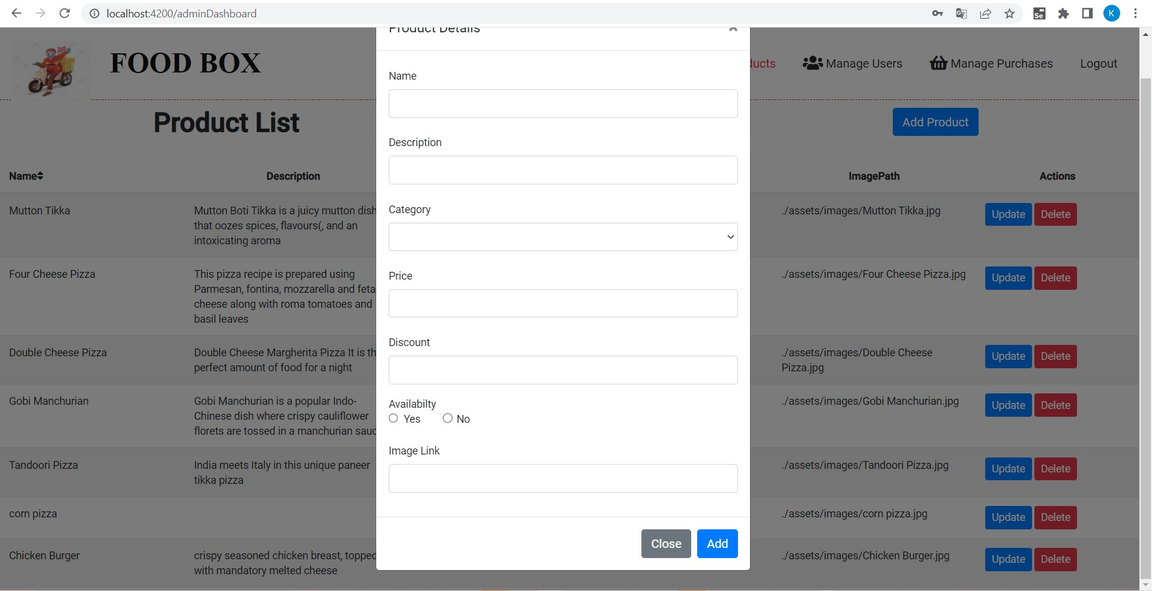
Adding Products

Slide 42
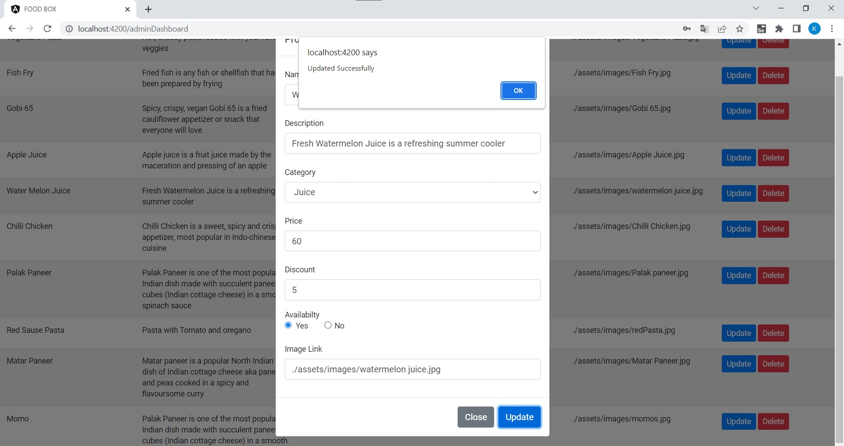
Updating Products

Slide 43
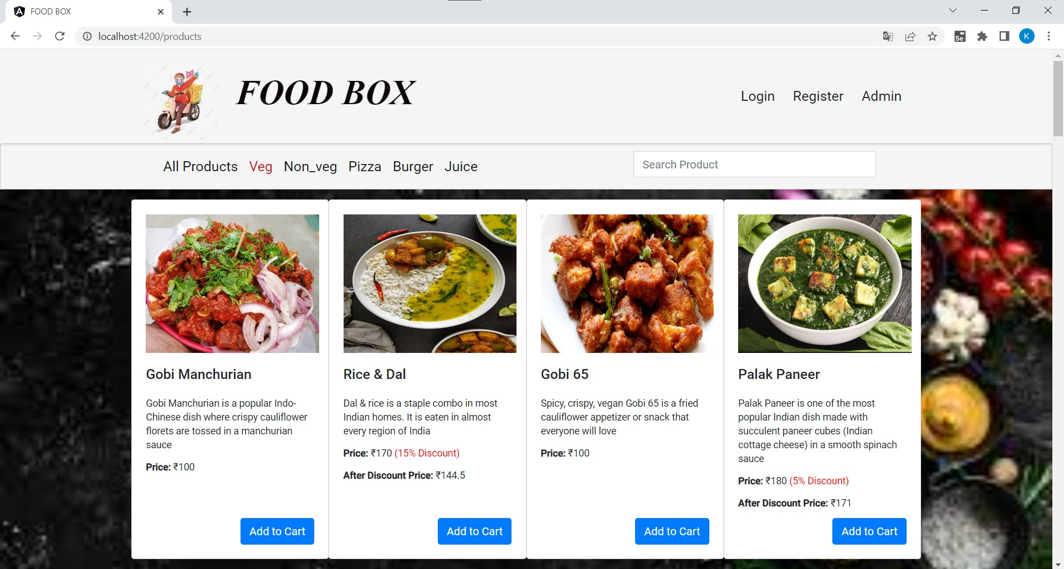
Veg Section

Slide 44
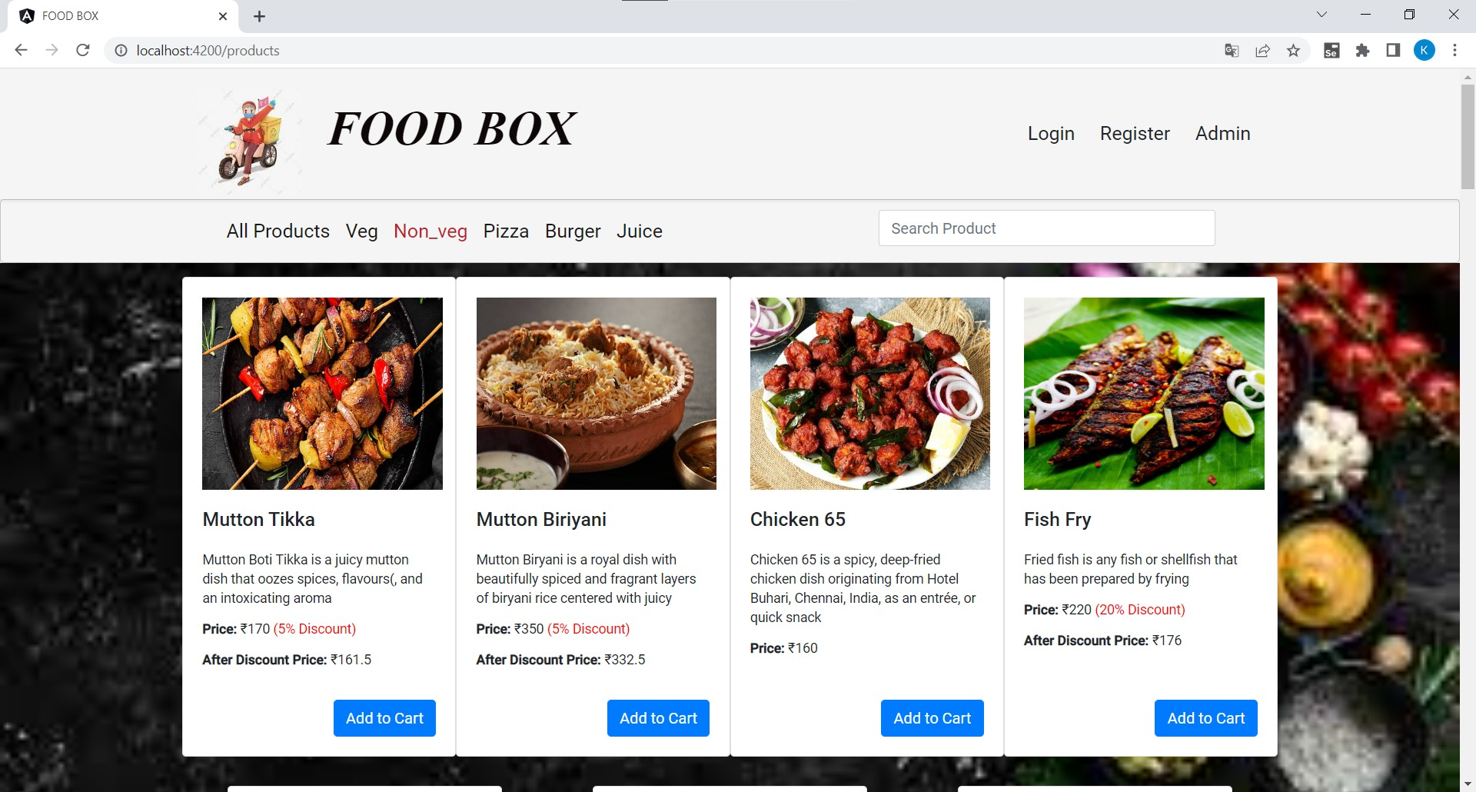
Non-veg Section

Slide 45
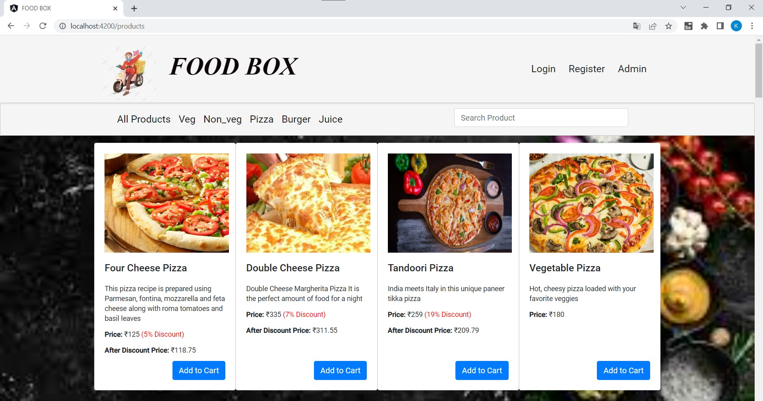
Pizza Section

Slide 46
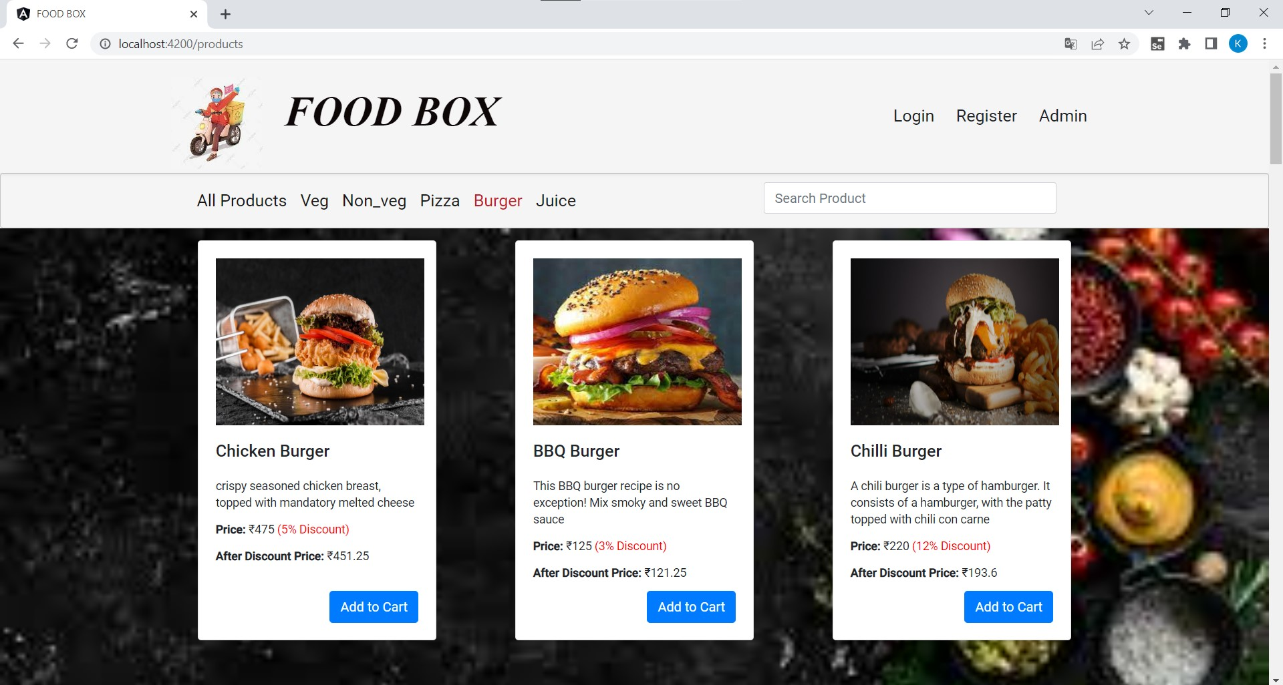
Burger Section

Slide 47
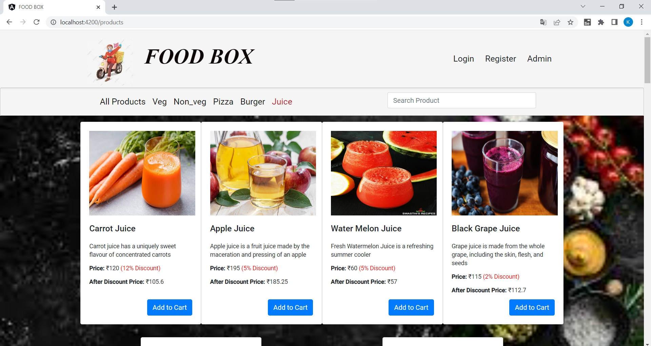
Juices

Slide 48
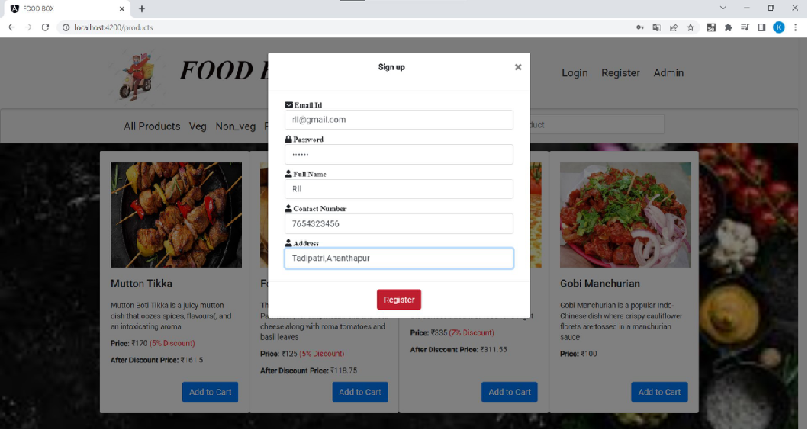
User Registration

Slide 49
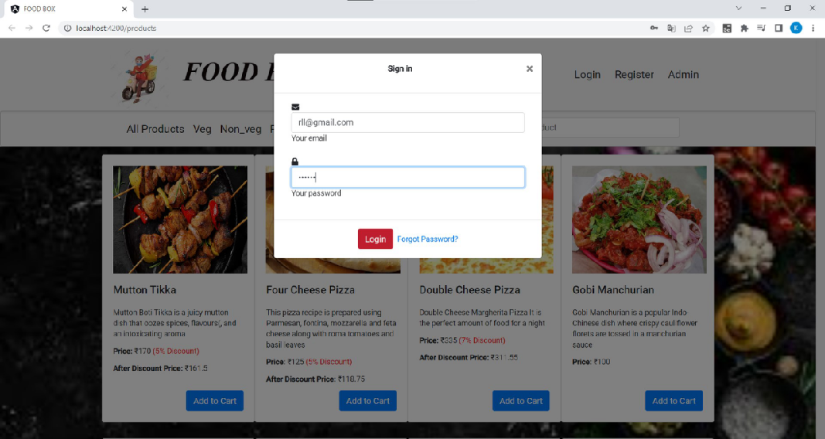
User Login

Slide 50
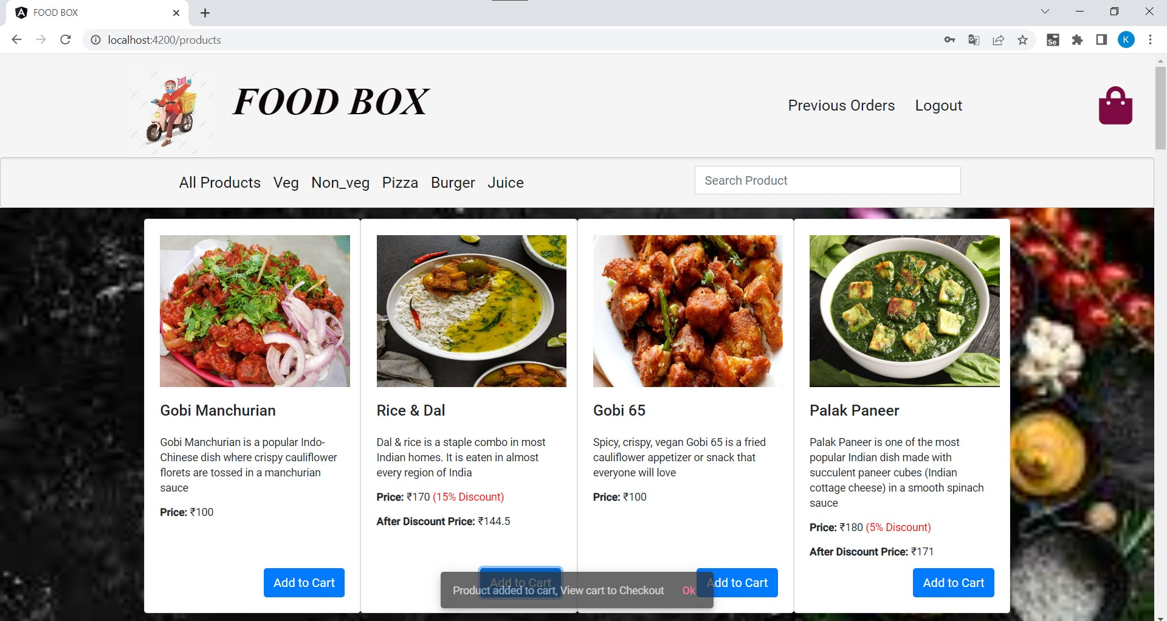

Slide 51
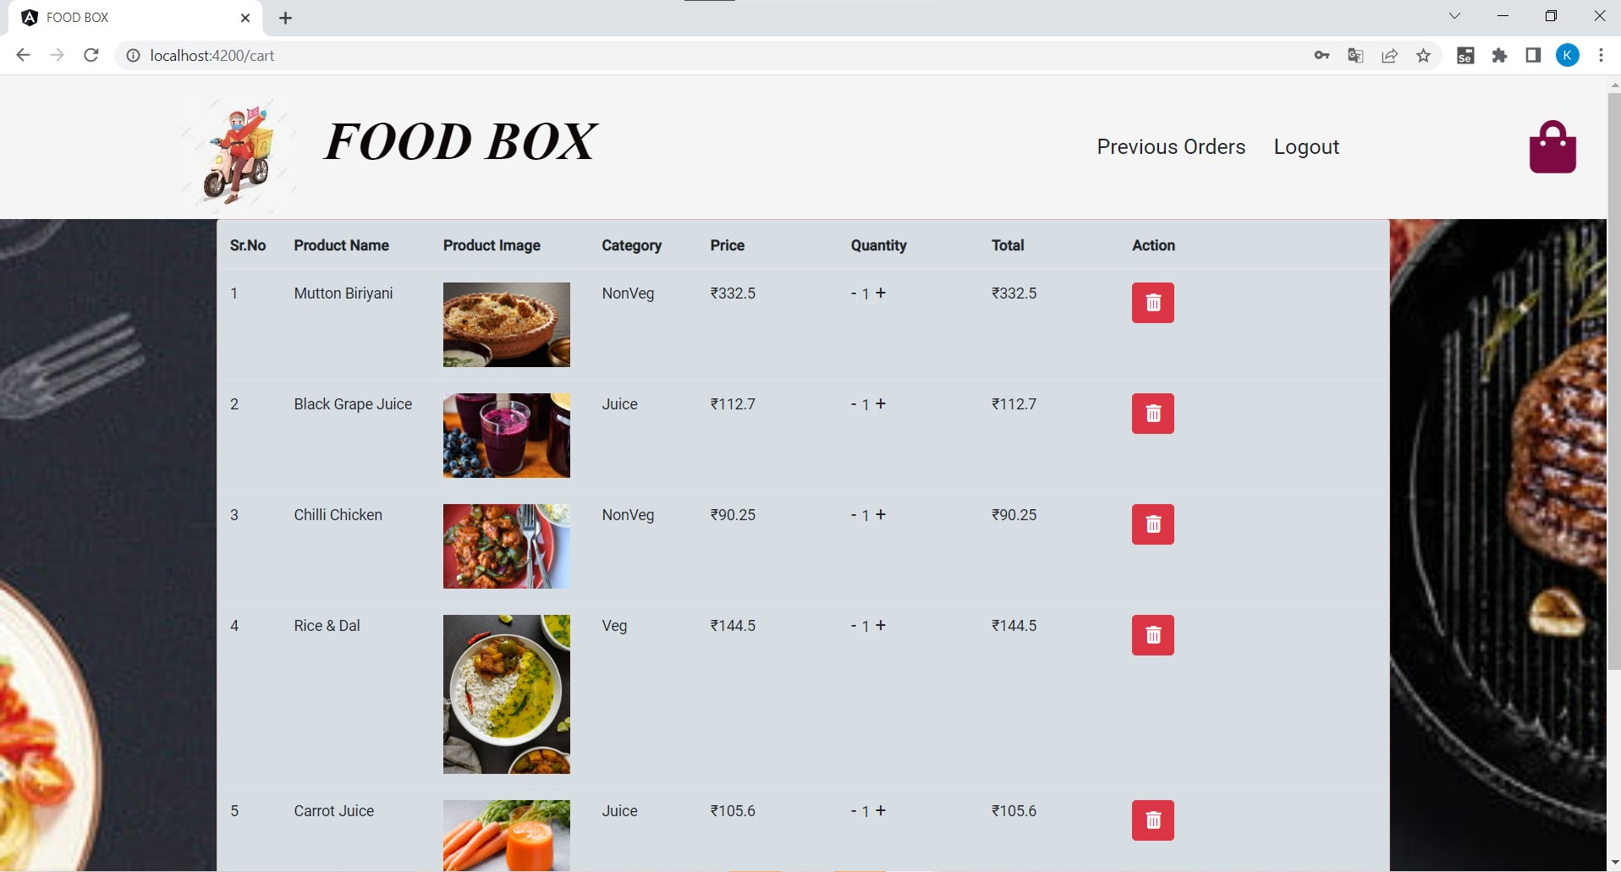
Cart Details

Slide 52
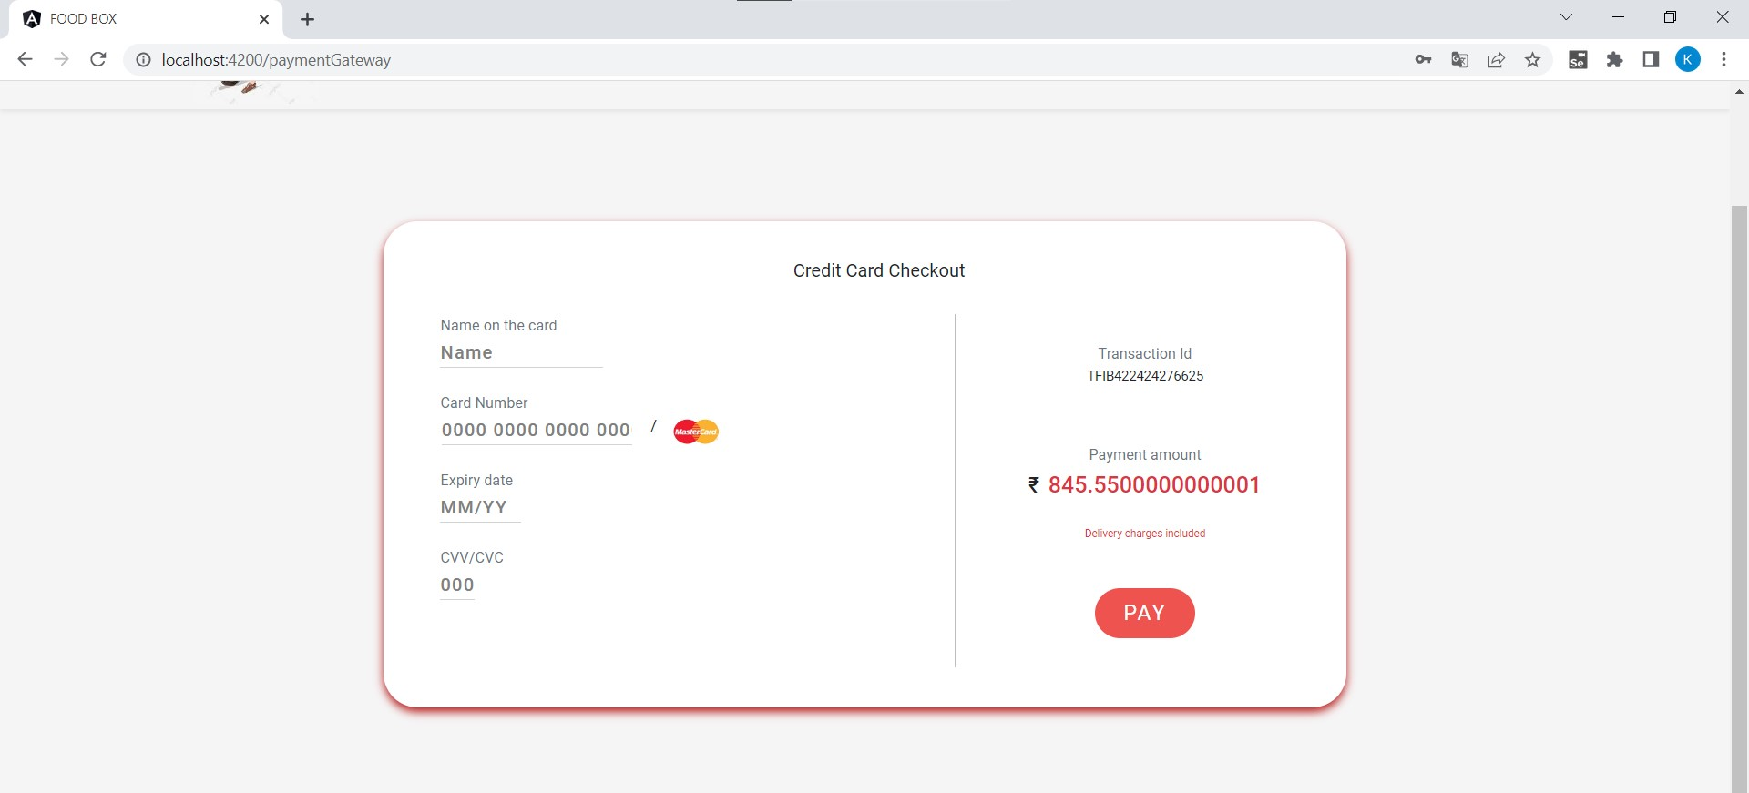
Payment Gateway

Slide 53
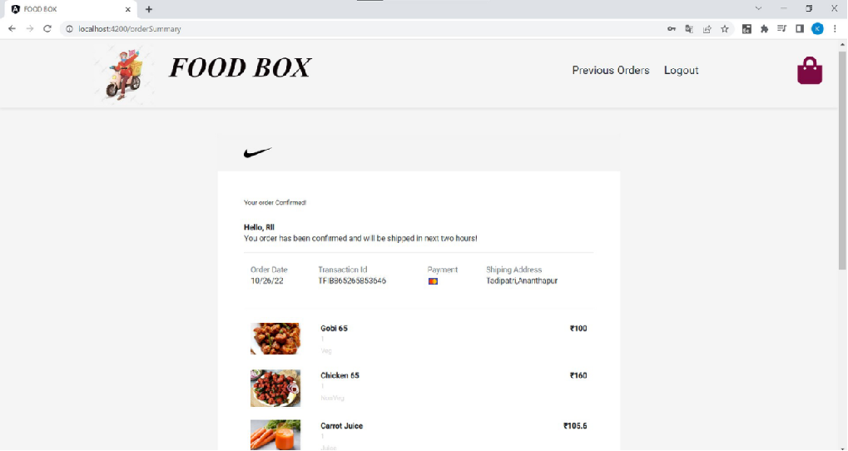
Order Summary

Slide 54
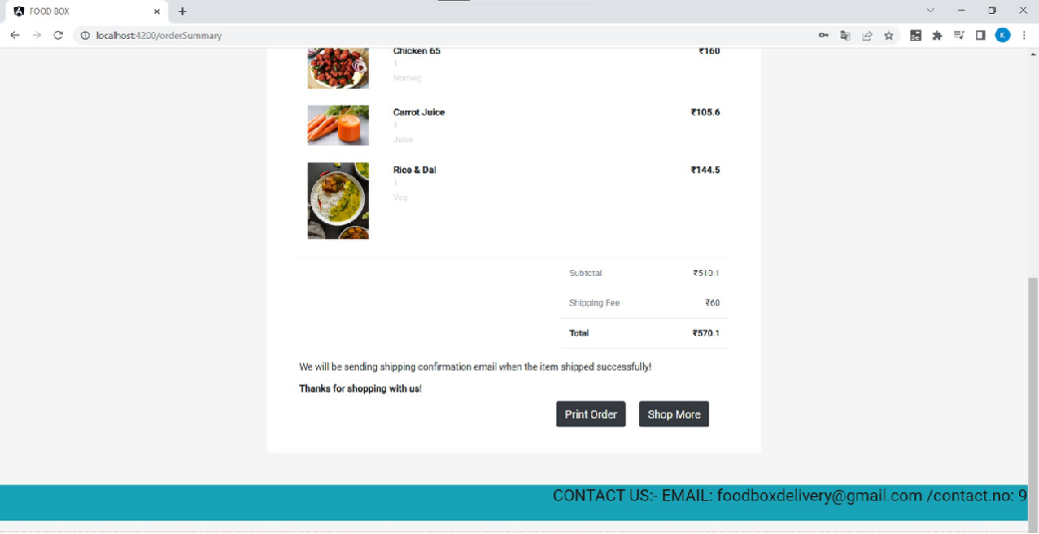

Slide 55
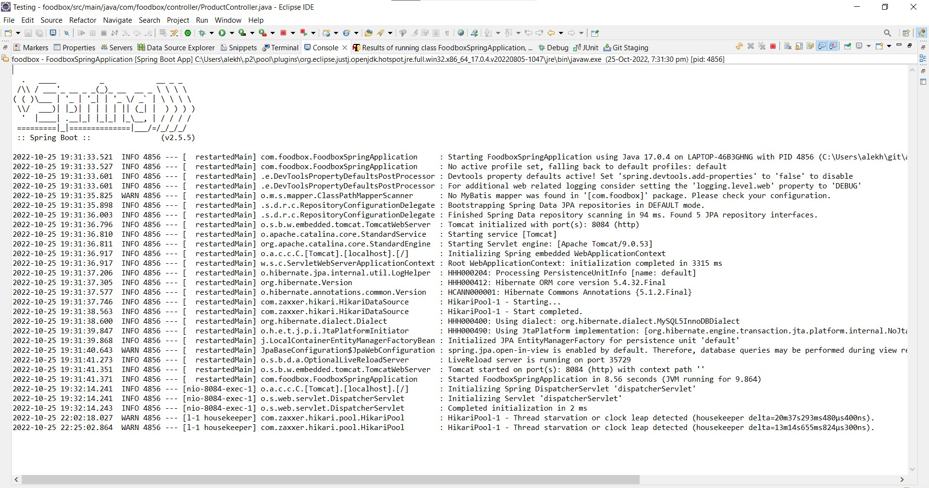

Slide 56
Thank you

